Slide 1
TEAM 6
Yuxin He, Roshan Poduval, Ching-Wen Wang

Slide 2


Goal
To predict stars for reviews

Slide 3
Process
Data visualization & Data processing
Generate new predictors from Date, Categories, and Text
Use linear regression model and Cross-Validation to do analysis

Slide 4
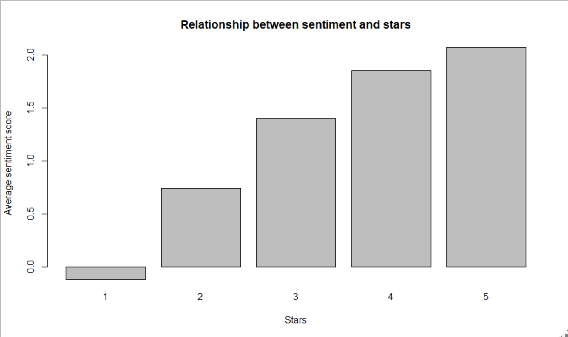
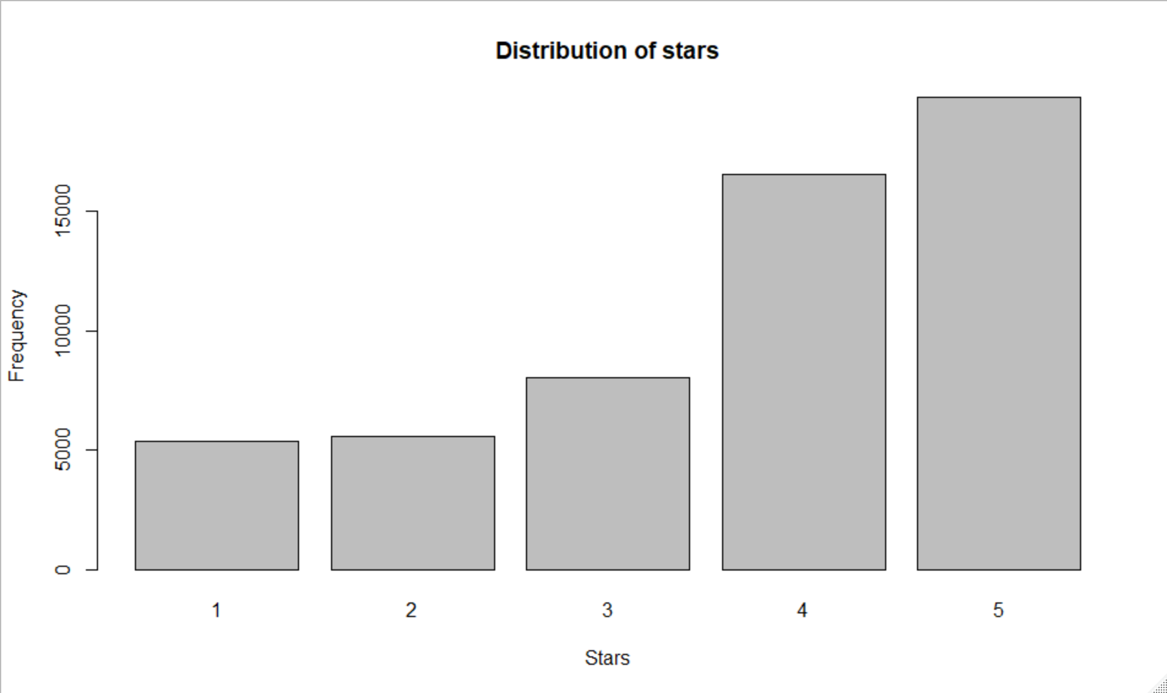
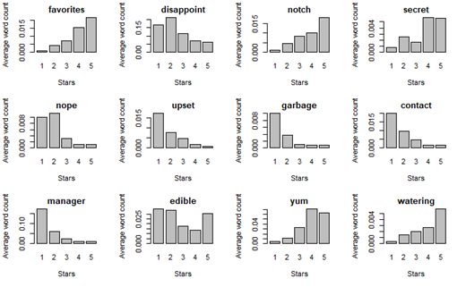
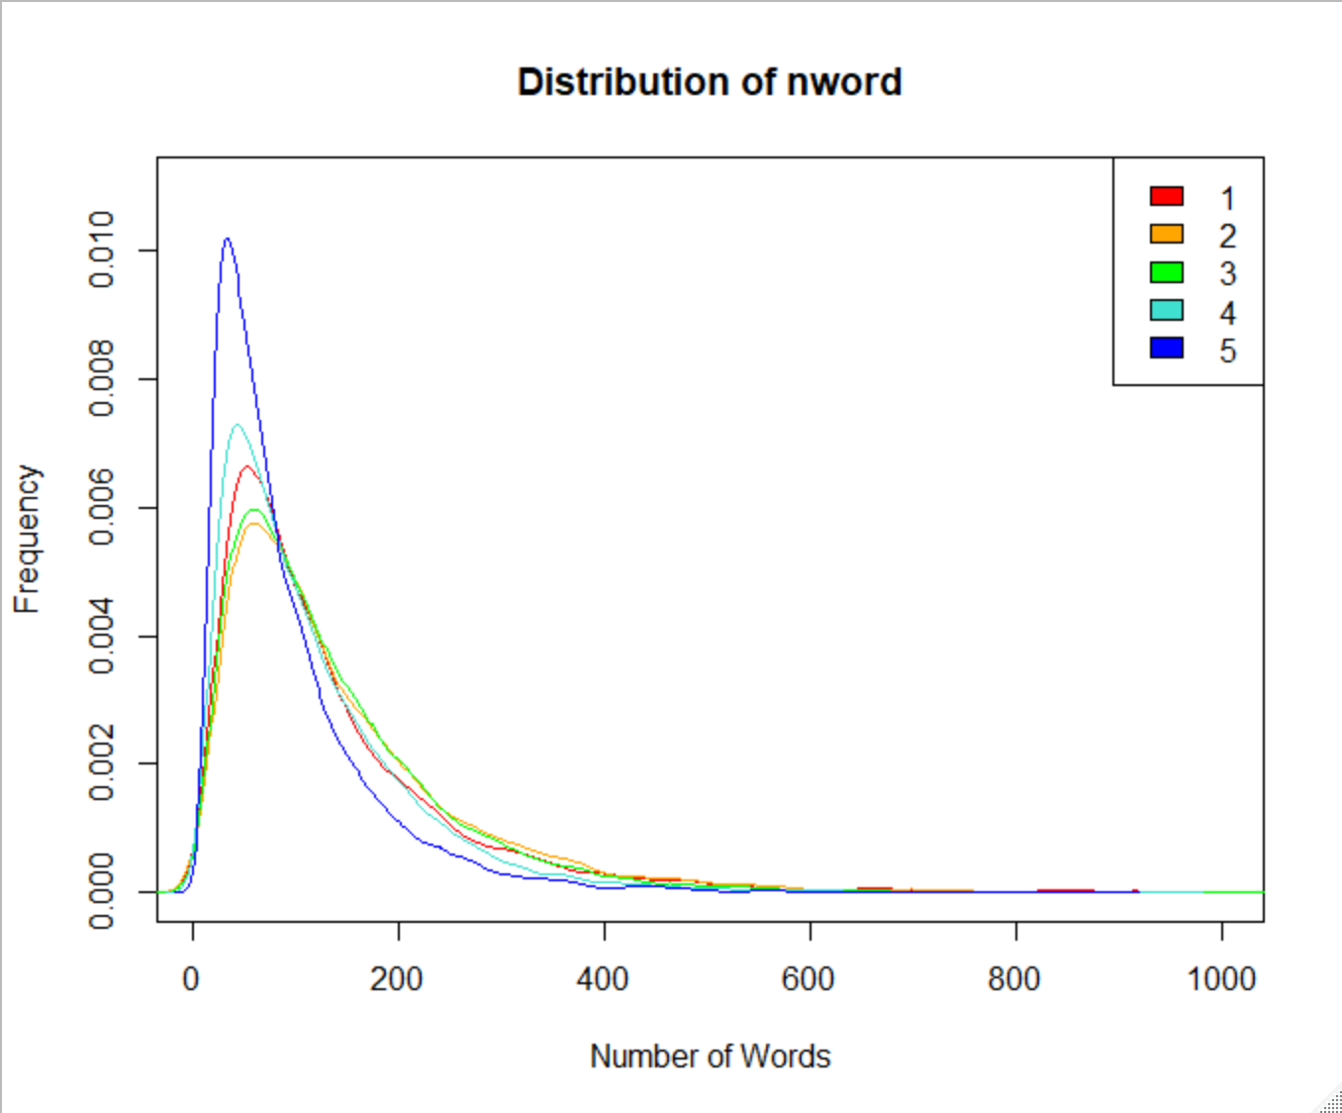
1. Data Visualization

Slide 5
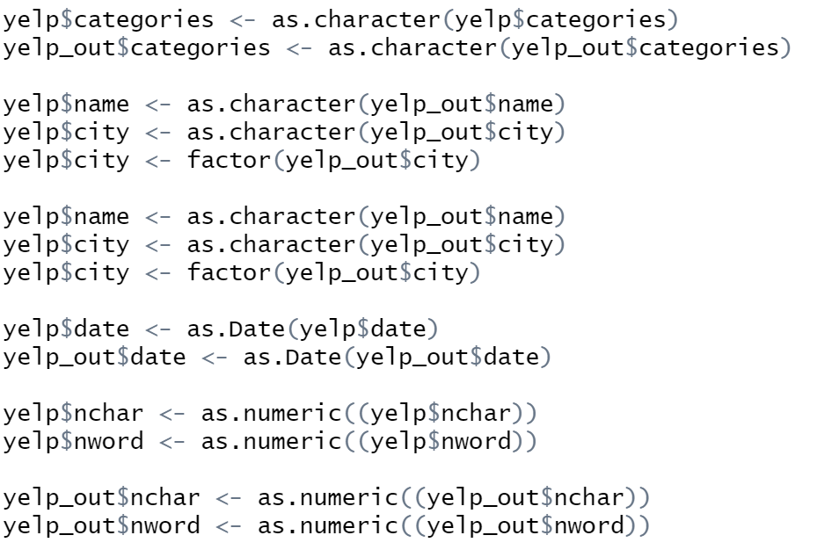
Data converting
Categories
City
Date

Slide 6
2. New Predictors: Date & Country & New words
Time
Season
Month
Week days
Country
American, Italian, Chinese, Mexican… etc.
New Words
Capitalized word from high frequency list
We also hand pick words and phrases with high frequency

Slide 7
Relationship between seasons and star
season | 1 star | 2 star | 3 star | 4 star | 5 star | season_sum
spring | 1232 | 1354 | 1937 | 3927 | 4768 | 13218
summer | 1531 | 1560 | 2232 | 4590 | 5736 | 15649
fall | 1474 | 1431 | 2023 | 4208 | 4855 | 13991
winter | 1139 | 1243 | 1826 | 3850 | 4426 | 12484
Number = number of Reviews
Spring = March, April, May
Summer = June, July, August
Fall = September, October, November
Winter = December, January, February

Slide 8
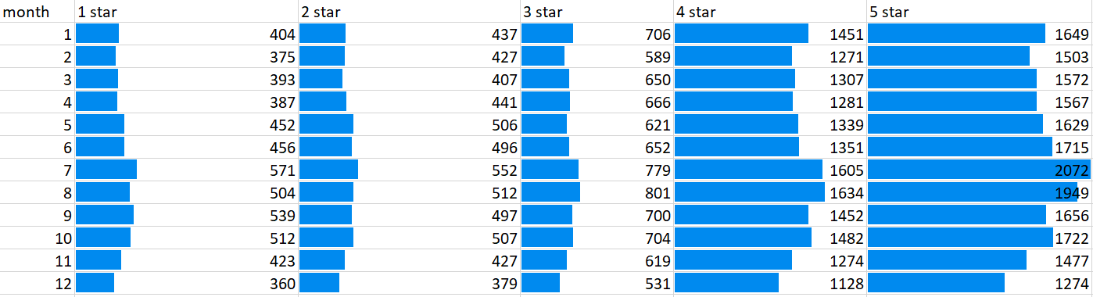
Relationship between months and star
Number = number of Reviews

Slide 9
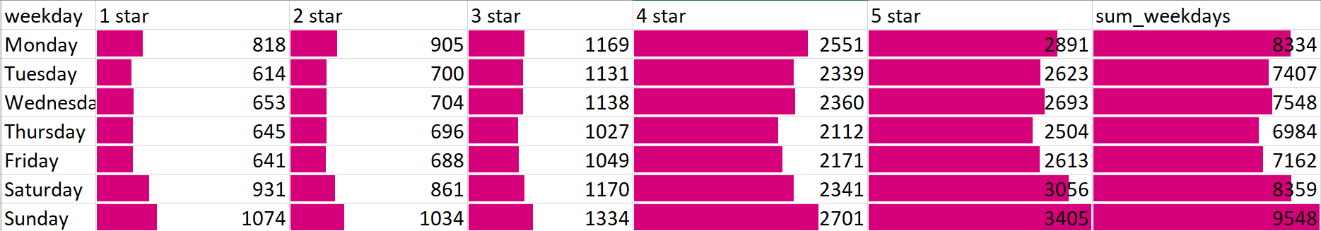
Relationship between weekdays and star
Number = number of Reviews
Notes:
We can see yelp as a series of data points happened in time. In the data, the time is independent to each other, then it could be a predicting features.
Also, some restaurants is seasonal. For example, fresh cool drinks food cart is always the most popular food courts near the memorial library. People tend to give them a higher review at hot summer.

Slide 10
Relationship between country and stars
Y-axis = number of Reviews

Slide 11
Relationship between country and stars
Y-axis = number of Reviews
Notes:
As we can see, the amount of reviews of American restaurants are especially greater than restaurant from other countries. Also, yelp user are largely Americans, they may have a potential preference on certain food. For example, Chinese restaurant are sometimes spicy because many Chinese likes spicy, instead, Americans may prefer sweet stuff and then result as a low star for Chinese restaurant

Slide 12
Relationship between country and stars
Y-axis = number of Reviews

Slide 13
Model generated using Linear Regression,
Cross-Validation, and Lasso
Response: stars
Input Predictors:
Date : Season, Month, Week days
Useful, funny, cool
City
nchar, nwords
Sentiment
Countries (20): “Italian”, “Chinese”, “American”, ”Thai”….
All the Word Predictors in “Yelp_train.csv” and self-picked words/phrases

Slide 14
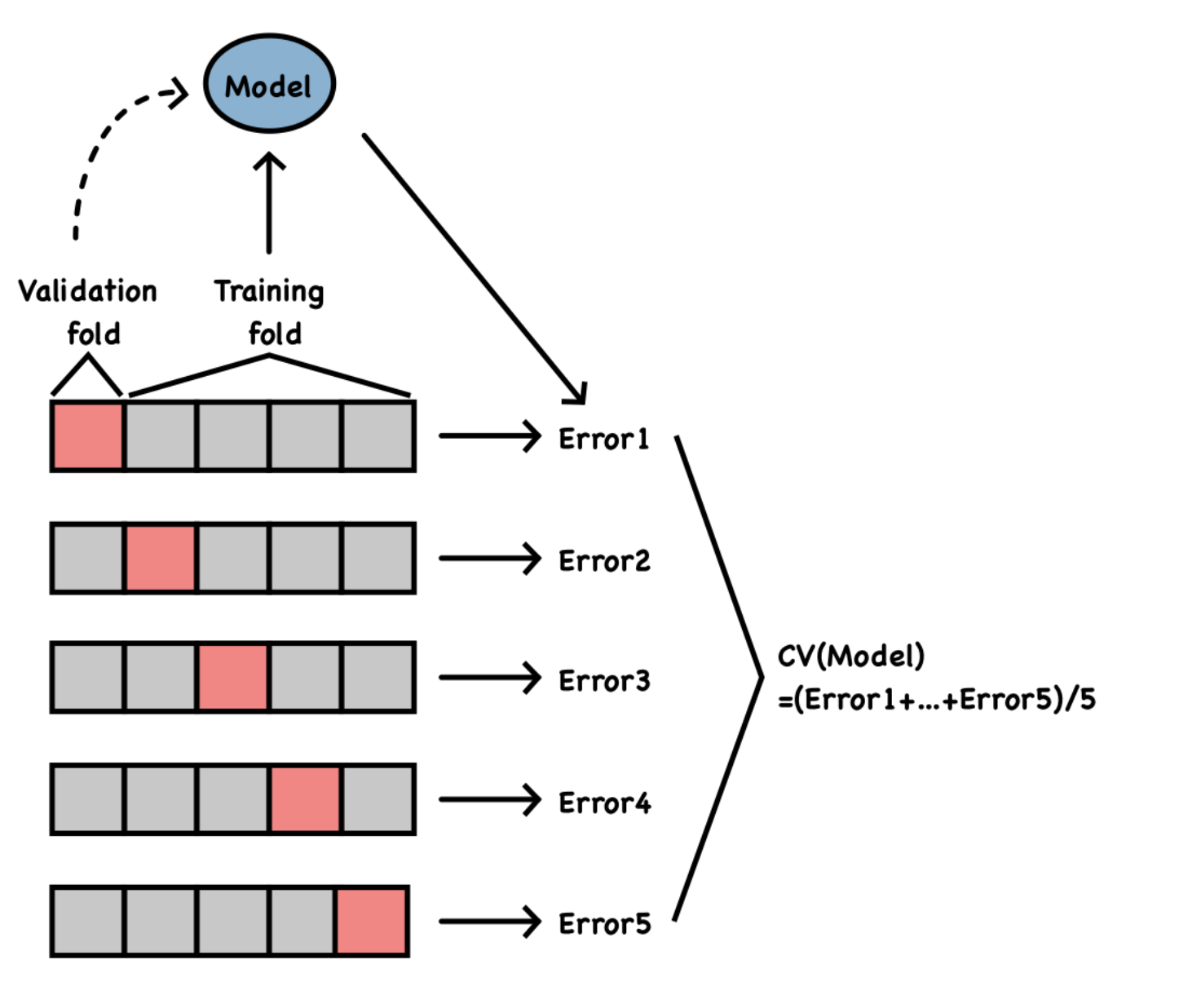
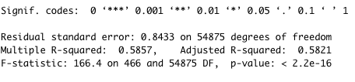
Cross-Validation

Slide 15
Model generated using Linear Regression,
Cross-Validation, and Lasso
Response: stars
Output Predictors: (Selected by p-value of lm, Cross-Validation, and Lasso)
Date : Season, Month, Week days
Useful, funny, cool
City
nchar, nwords
Sentiment
Countries (20): “Italian”, “Chinese”, “American”, ”Thai”….
All the Word Predictors in “Yelp_train.csv” and self-picked words/phrases
RMSE: 0.84784
Total of 519 predictors

Slide 16


Prediction on Training Data

Slide 17
THANK YOU
Yuxin He, Roshan Poduval, Ching-Wen Wang

